Slide 1


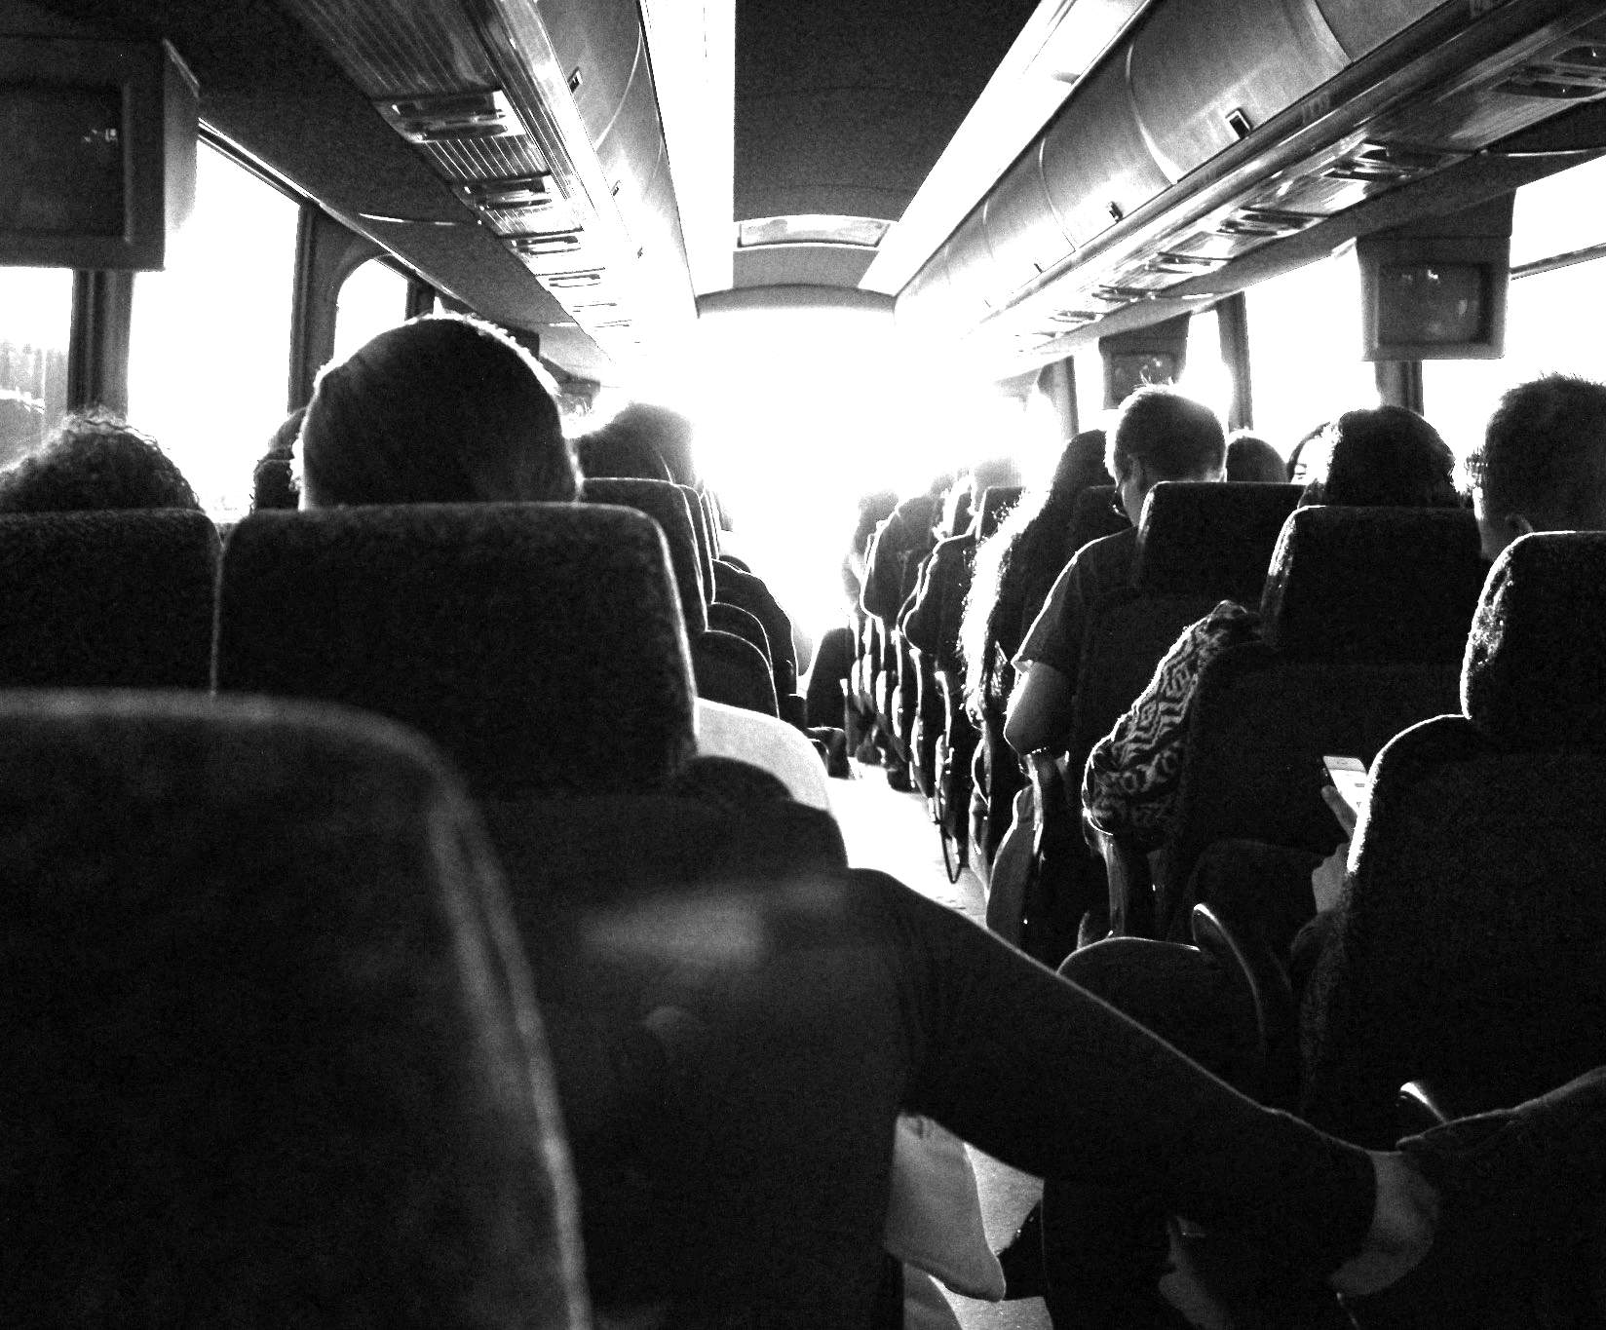

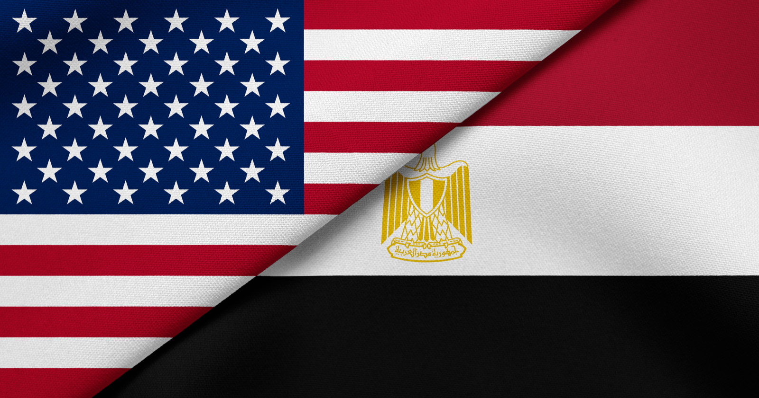
Sobek Transit
سوبيك ترانزيت
Soliman (So), Badreldin (BE), Keshav (K)

Slide 2
TABLE OF CONTENTS
01
02
03
04
05
06
07
08
09
What is sobek?
Why was Sobek Built?
(The Problem)
Why to use sobek? (Our Solution)
Demo
How was Sobek Built?
Testing & Feedback
Questions
The future
Our team

Slide 3
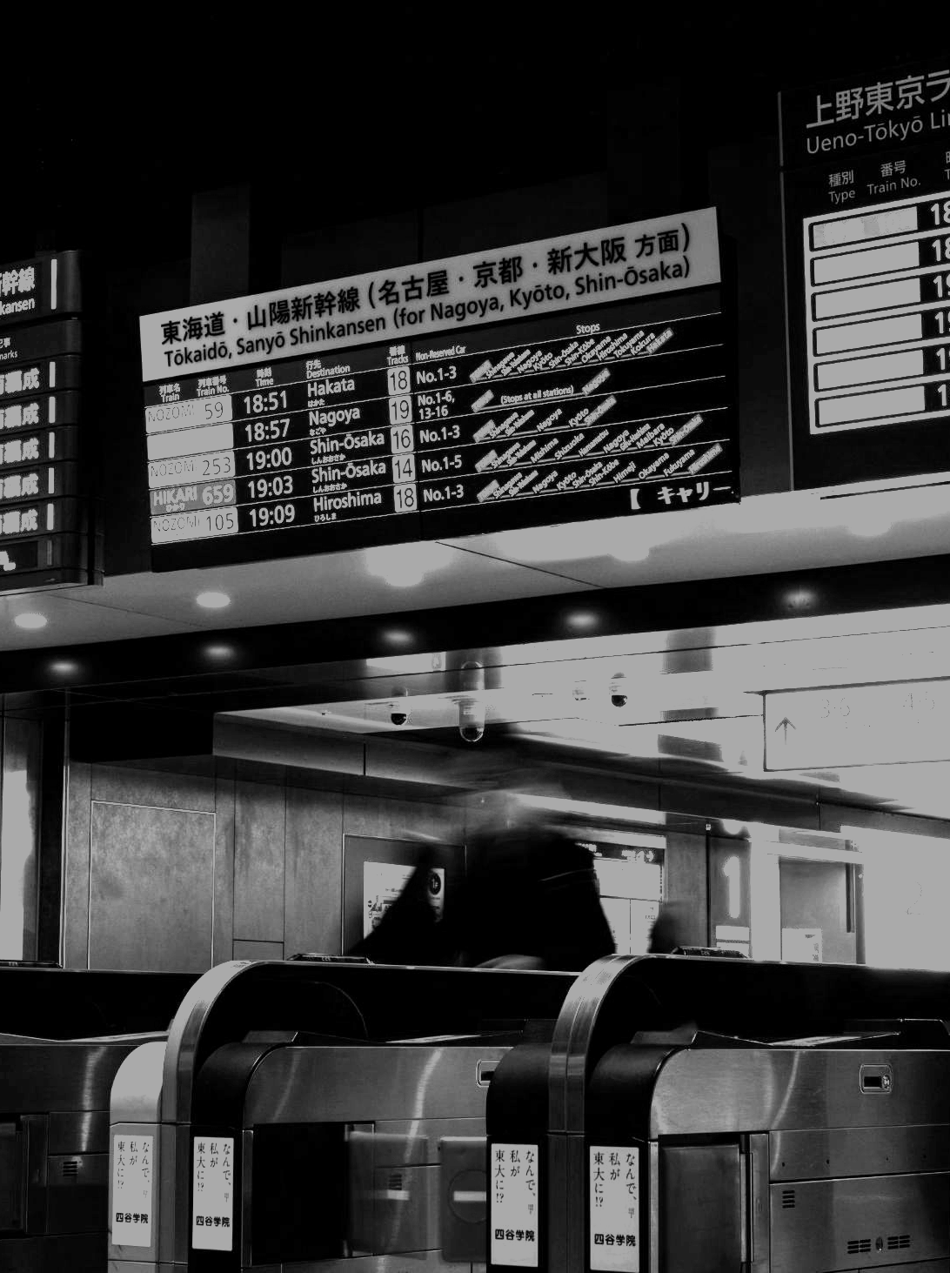
01
What is Sobek?

Slide 4
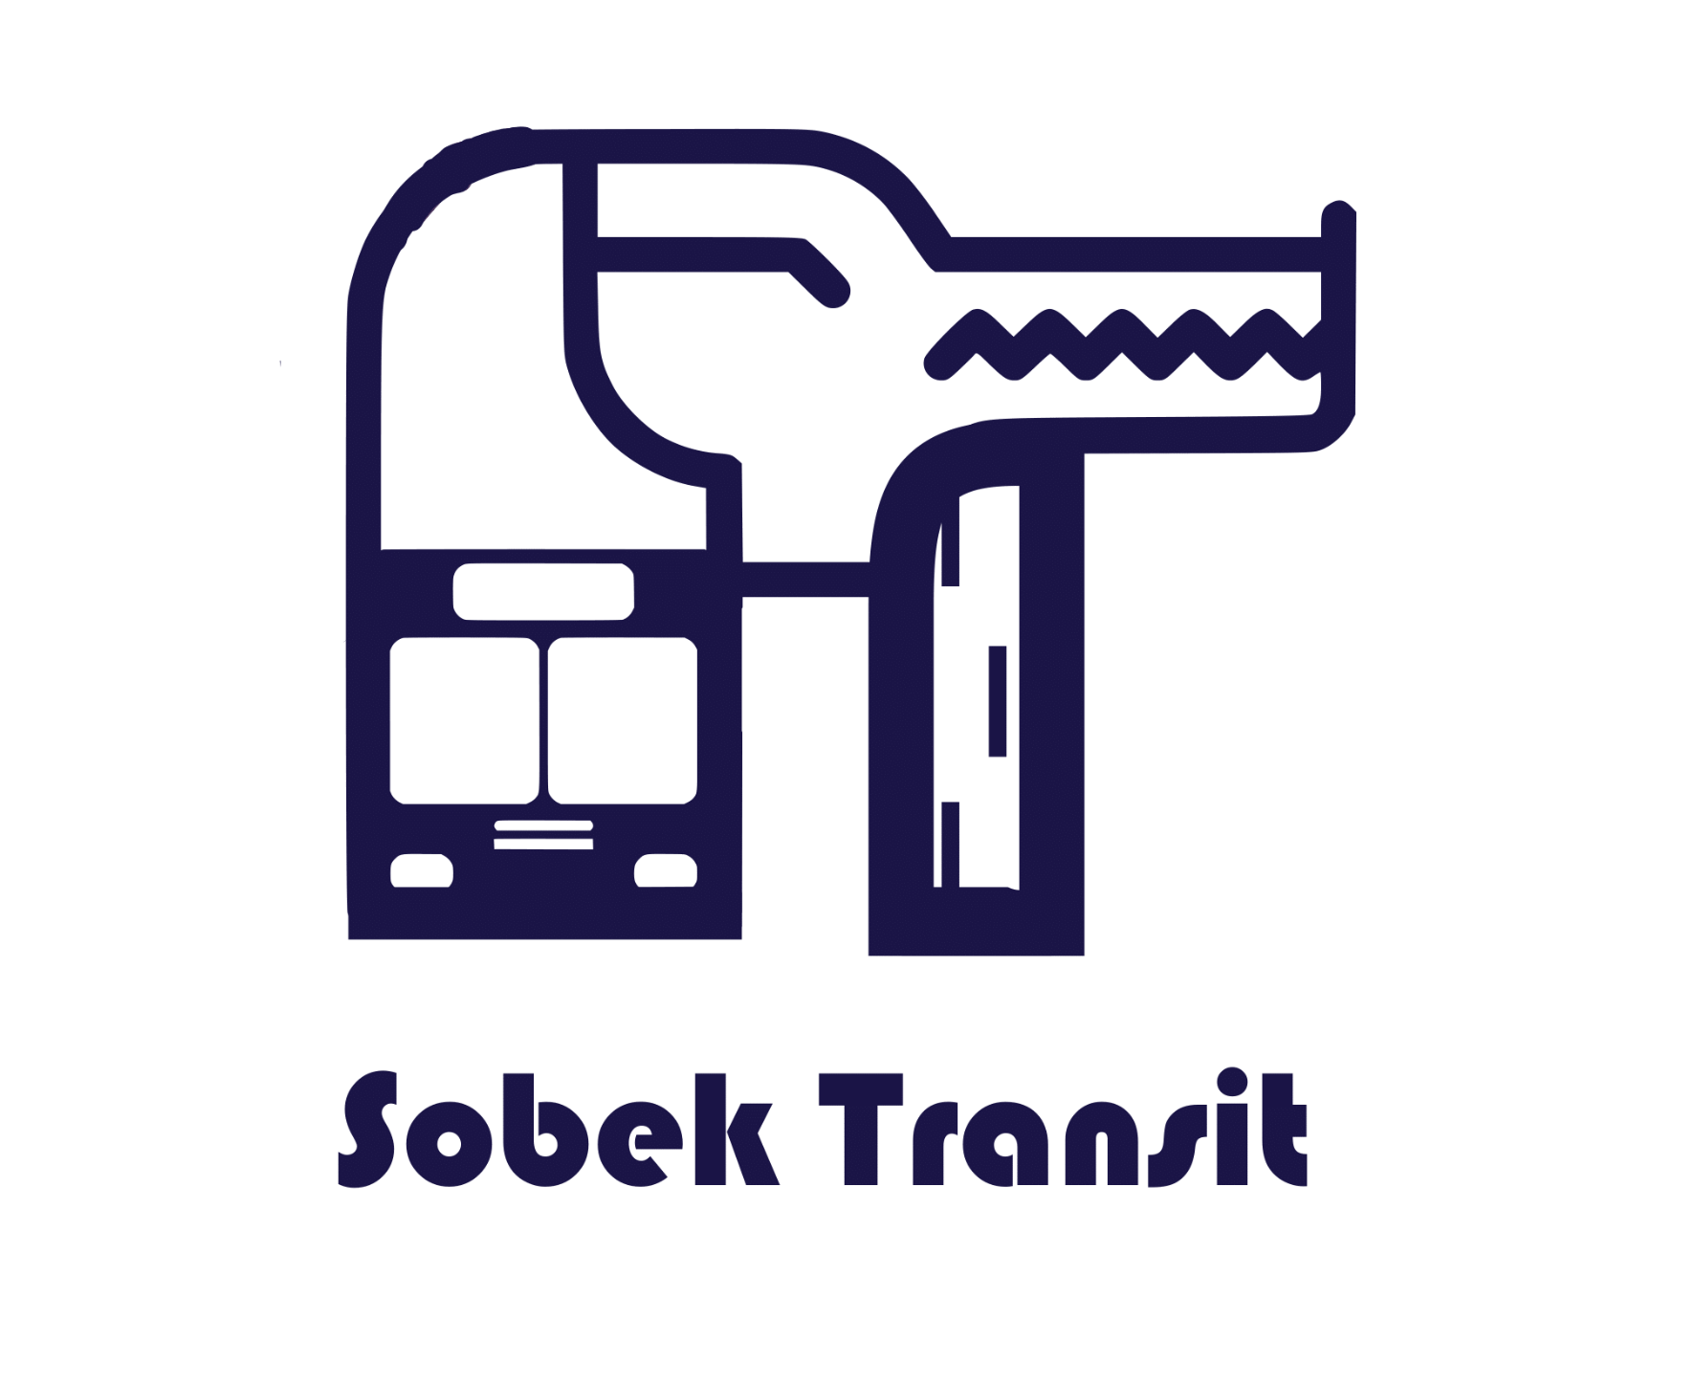
What is Sobek?
"Sobek" is an Egyptian deity revered for his connection to the Nile river, and crocodiles in ancient Egyptian mythology.
The decision to name our transit system "Sobek" was inspired by the strength and reliability of the crocodile, which is a symbol of transportation.
Alternatively, "Sobek" could also be an acronym for the names of the team members who developed the system: Soliman (So), Badreldin (Be), and Keshav (K).

Slide 5
02
Why was Sobek Built?
(The Problem)

Slide 6
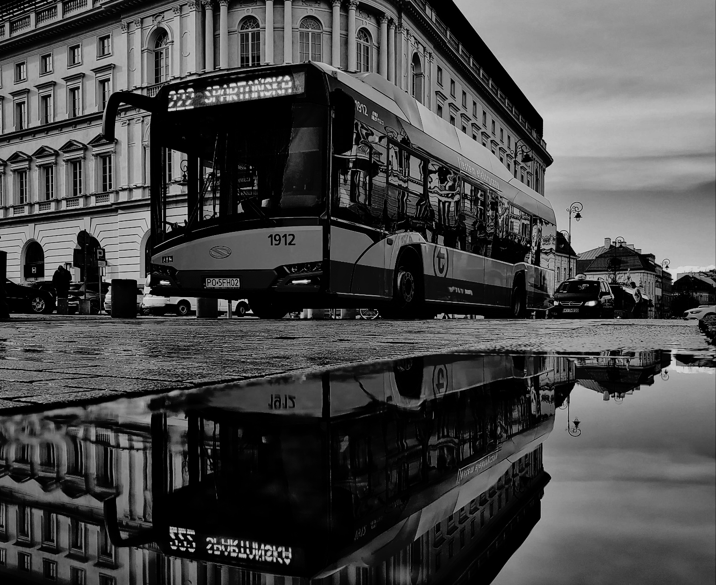
Why was Sobek Built? (The Problem)
The current AIU transportation system offers an inefficient and unreliable experience.
It is time consuming, lacks the means to see ride information, track the buses and link payment methods into the system.
It makes the process of managing such important process as transportation very difficult.

Slide 7
03
Why to use sobek? (Our Solution)

Slide 8
Why to use sobek? (Our Solution)
Sobek Transit system is designed to make the daily transit to and from AIU easier for everyone.
The system offers:
Seat availability and route information.
Estimated bus arrival and departure information.
Online booking and cancellation support.
Driver and overall travel experience ratings.
The ability to gather valuable user data and financial information to understand user behavior and provide better service in the future.

Slide 9
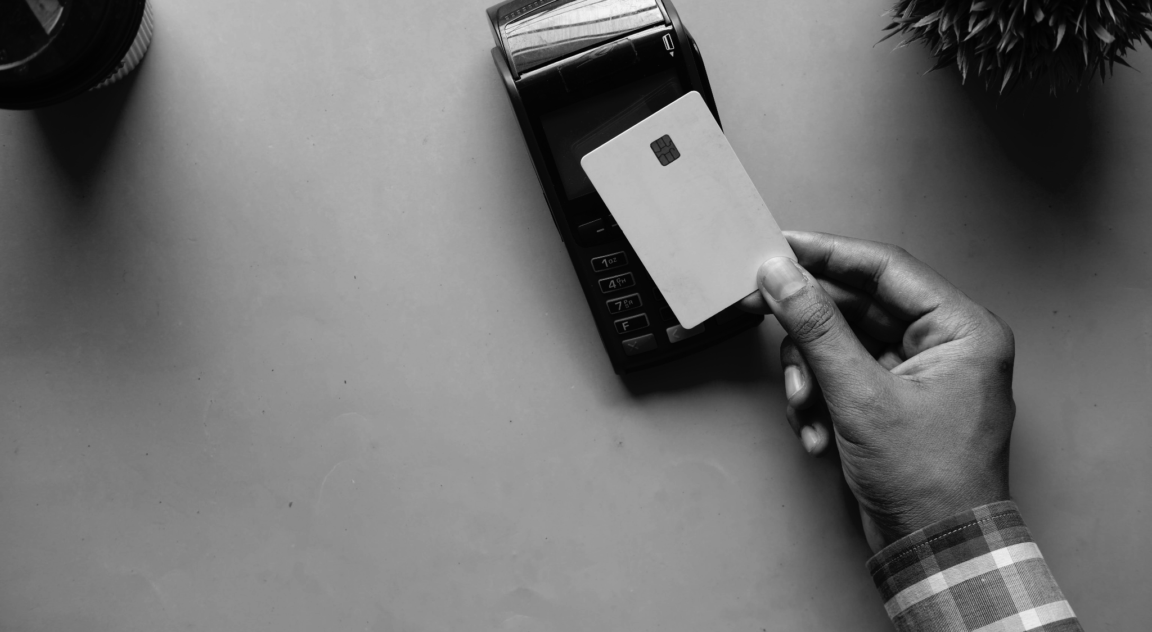
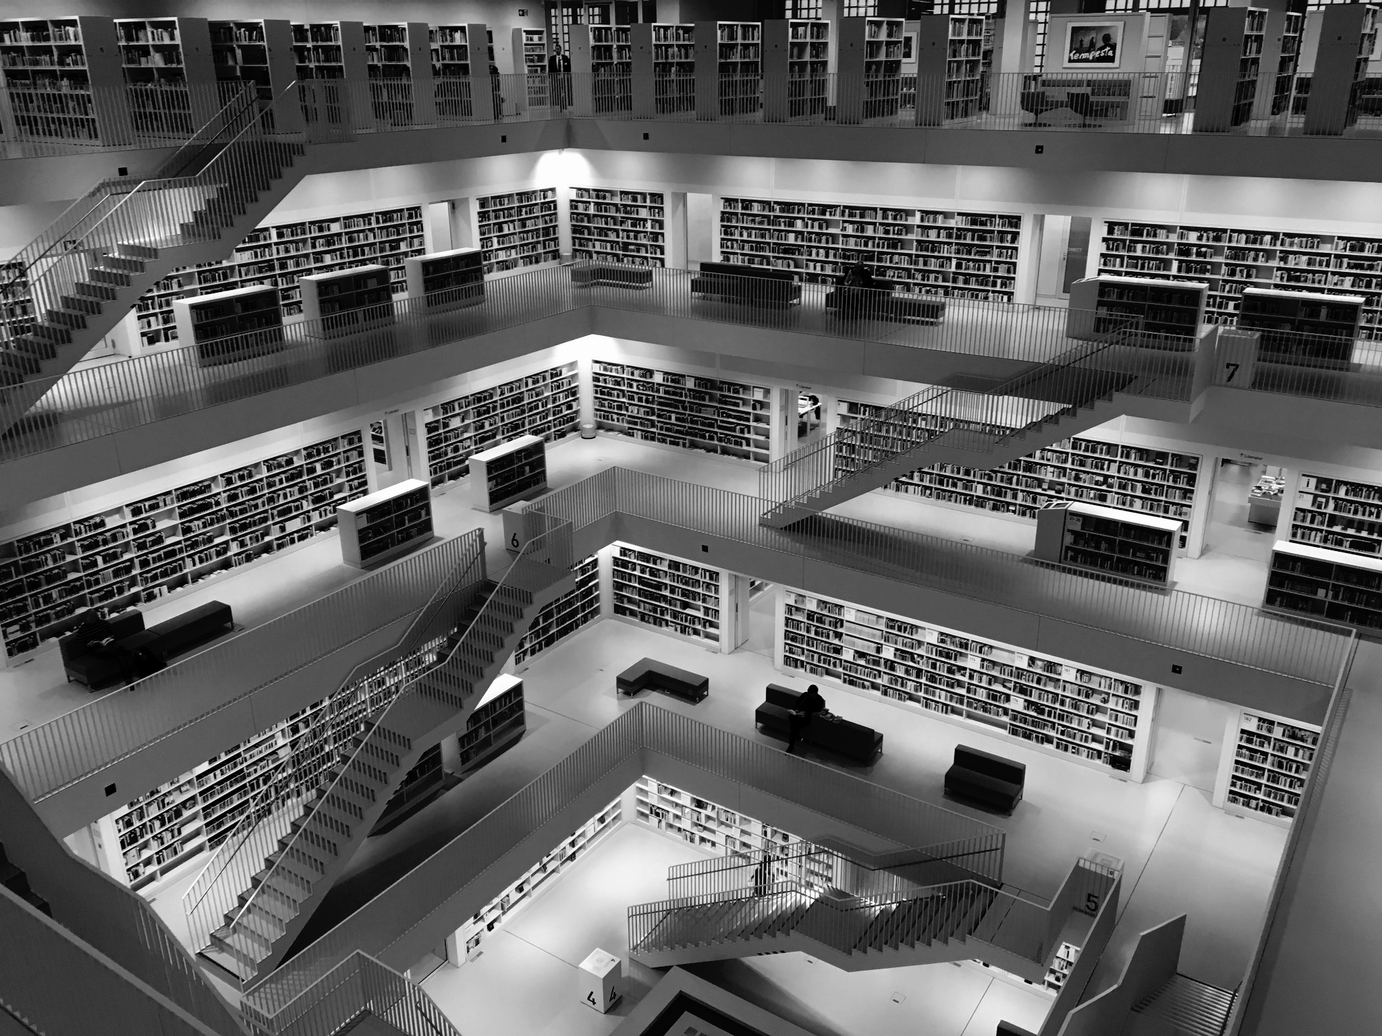
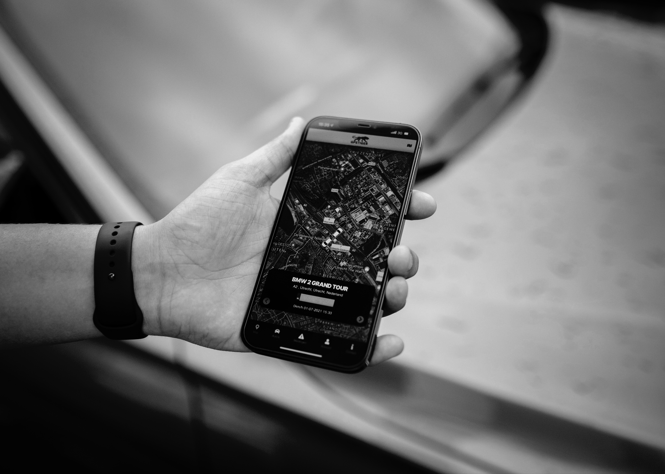
Why to use sobek? (Our Solution)
Secure API + Database
Estimated Tracking + Registration
Authorized connection to API endpoints with updated database.
Easy to navigate with bus routes on maps and seats left.
Payment Support
Secure and easy payment system with updated registration list.

Slide 10
04
How Was Sobek Built?

Slide 11
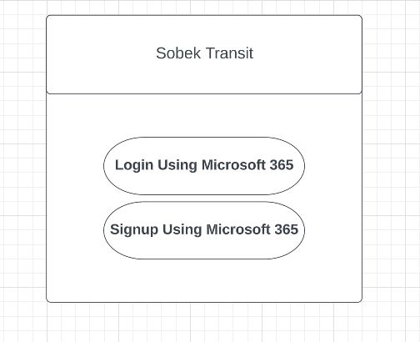
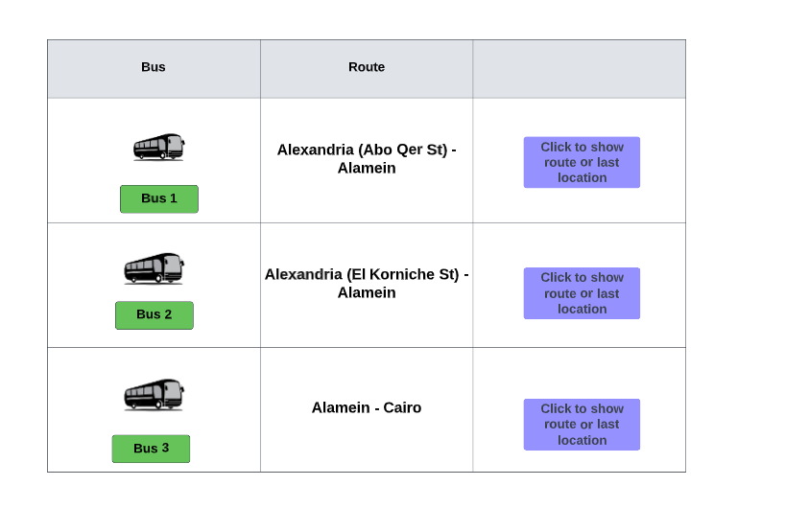
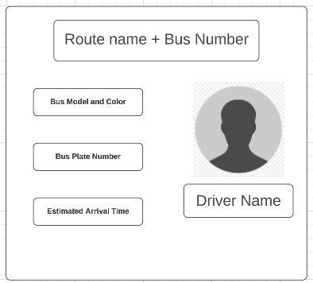
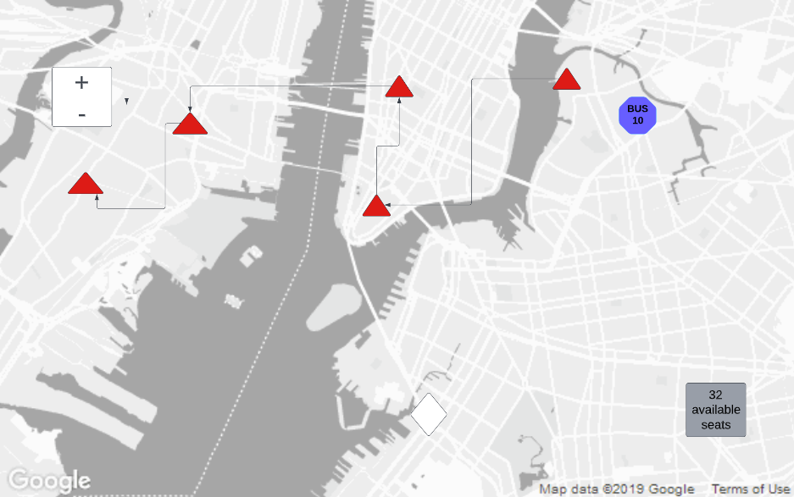
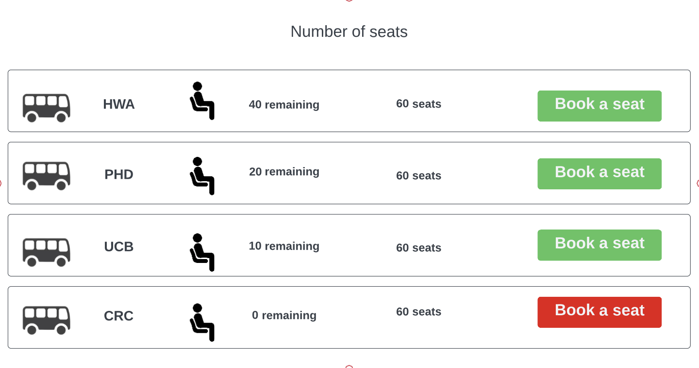
How was Sobek Built?
Early Concepts

Slide 12
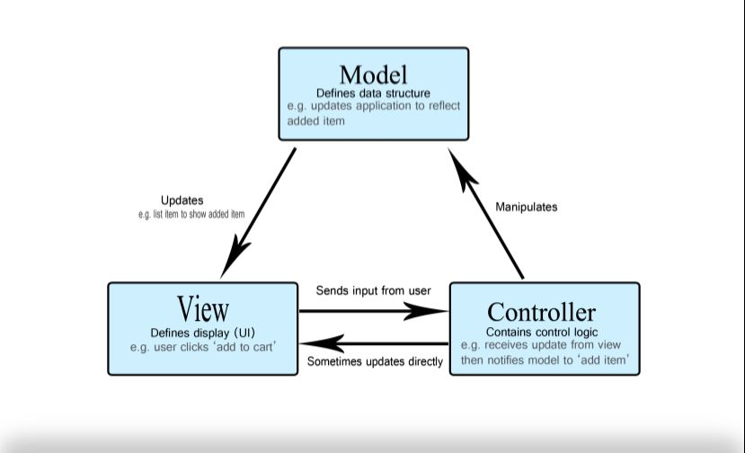
How was Sobek Built?
MVC

Slide 13
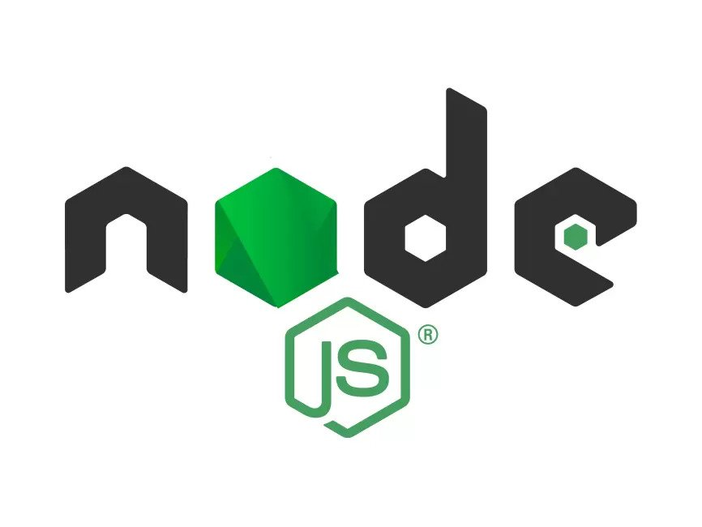
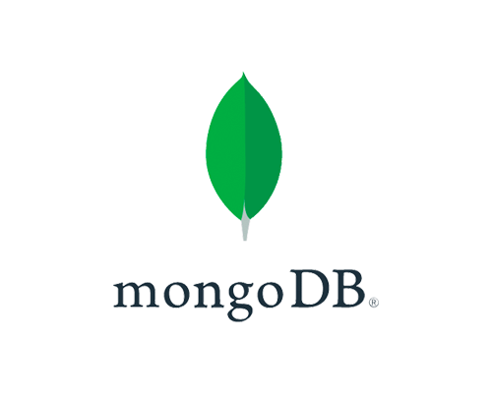
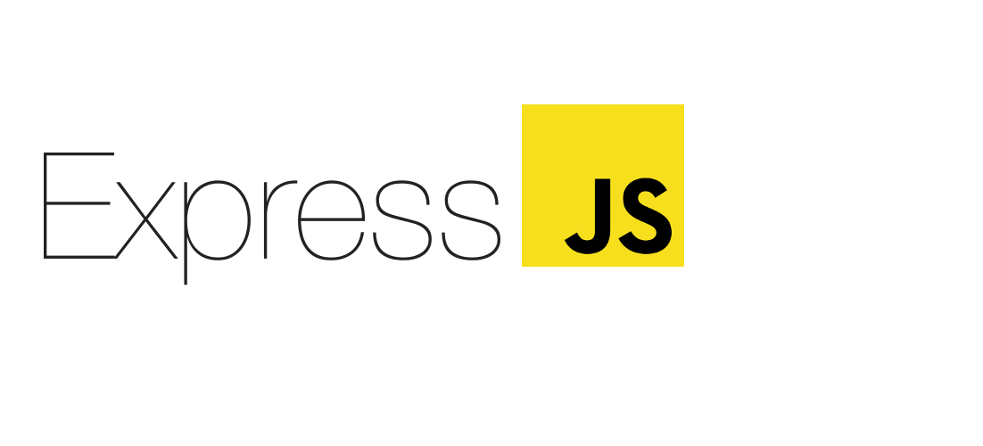
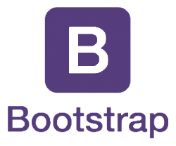


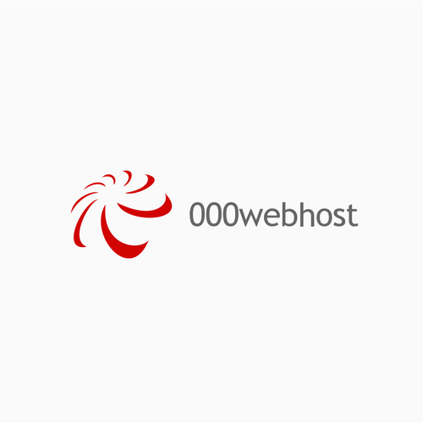


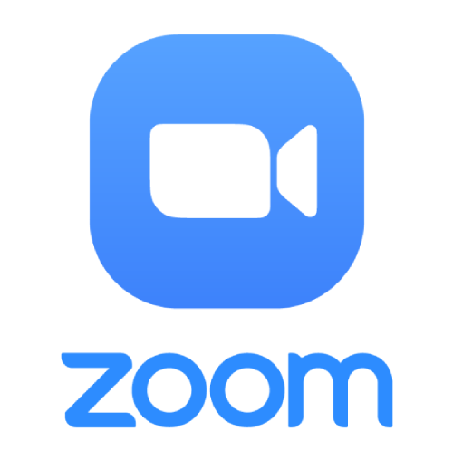
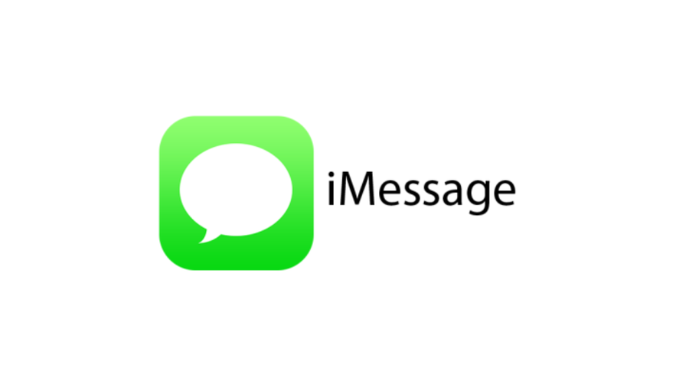
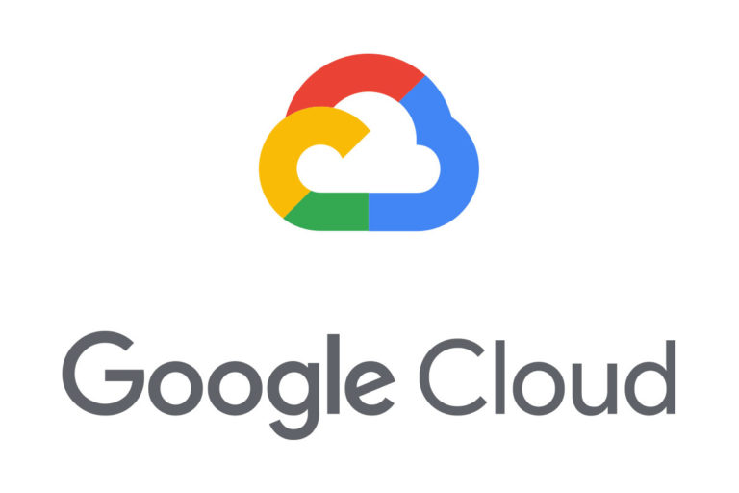
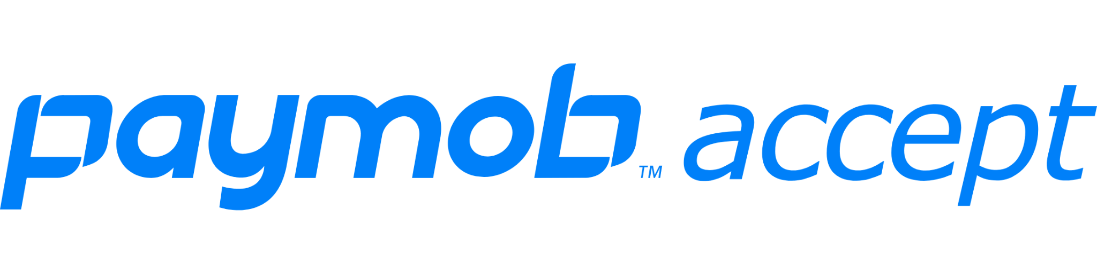
How was Sobek Built?

Slide 14
05
Testing & Feedback

Slide 15
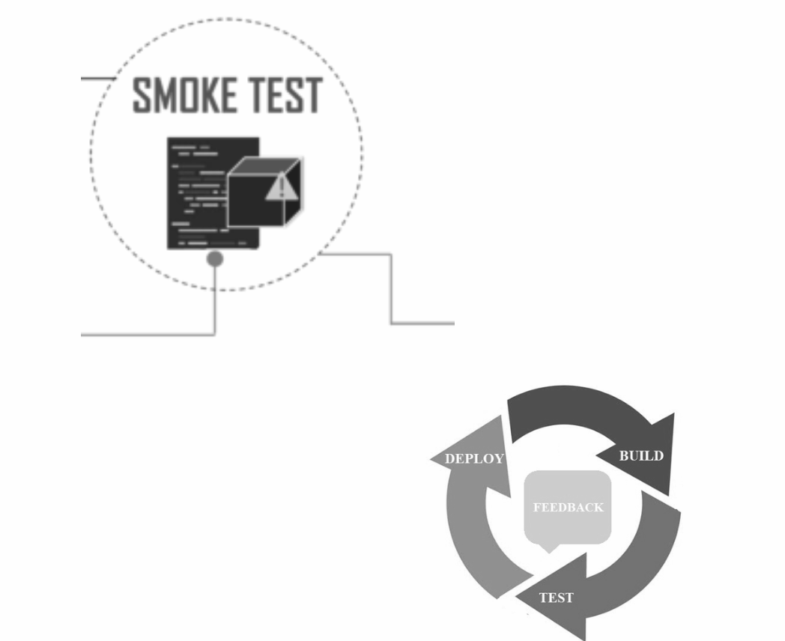
Testing & Feedback
We utilized both smoke testing and feedback-based testing methodologies in our project to ensure that our software was stable and met the needs of our users. Smoke Testing: A basic functionality check performed early in the software development life cycle to identify major issues or defects.
Feedback-Based Testing: An approach that focuses on gathering feedback from users or stakeholders to identify issues or defects in the software and improve its quality.

Slide 16
06
Demo

Slide 17
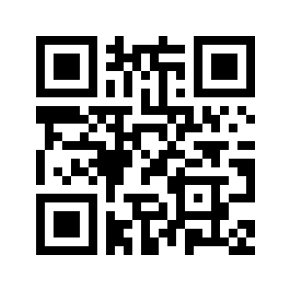
Demo
Try it yourself!
https://bit.ly/3oVqx6J

Slide 18
07
The Future

Slide 19
The Future
Live Tracking
Offline Route Information
Ios/Android Support
Automated messaging system to get bus route information, seats left, and registration.
Android App with the ability to get bus route information, register, and get support.
Live bus tracking and registration information updated every 10 seconds.

Slide 20
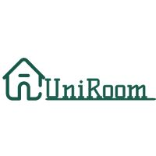
The Future
Cooperation with UNIROOM
To provide all services for AIU Society in a Smart way

Slide 21
08
Our Team

Slide 22
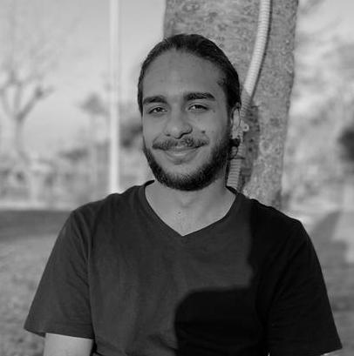
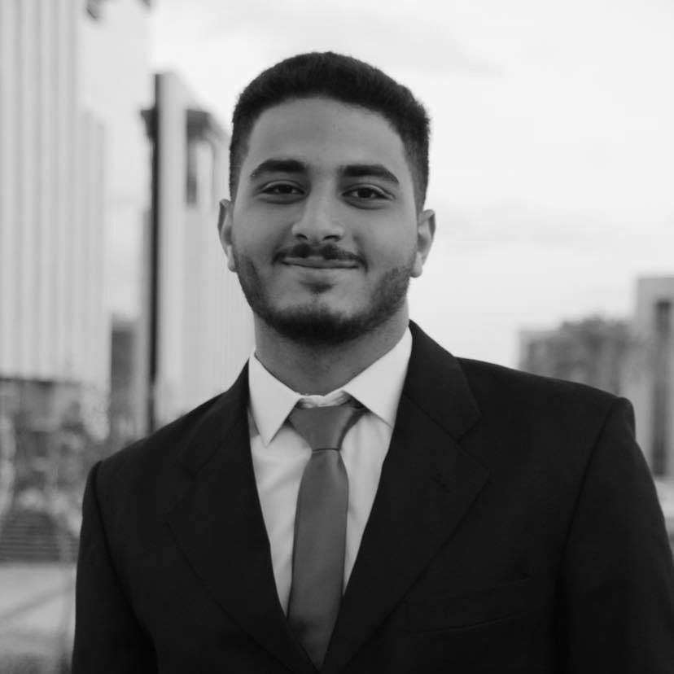
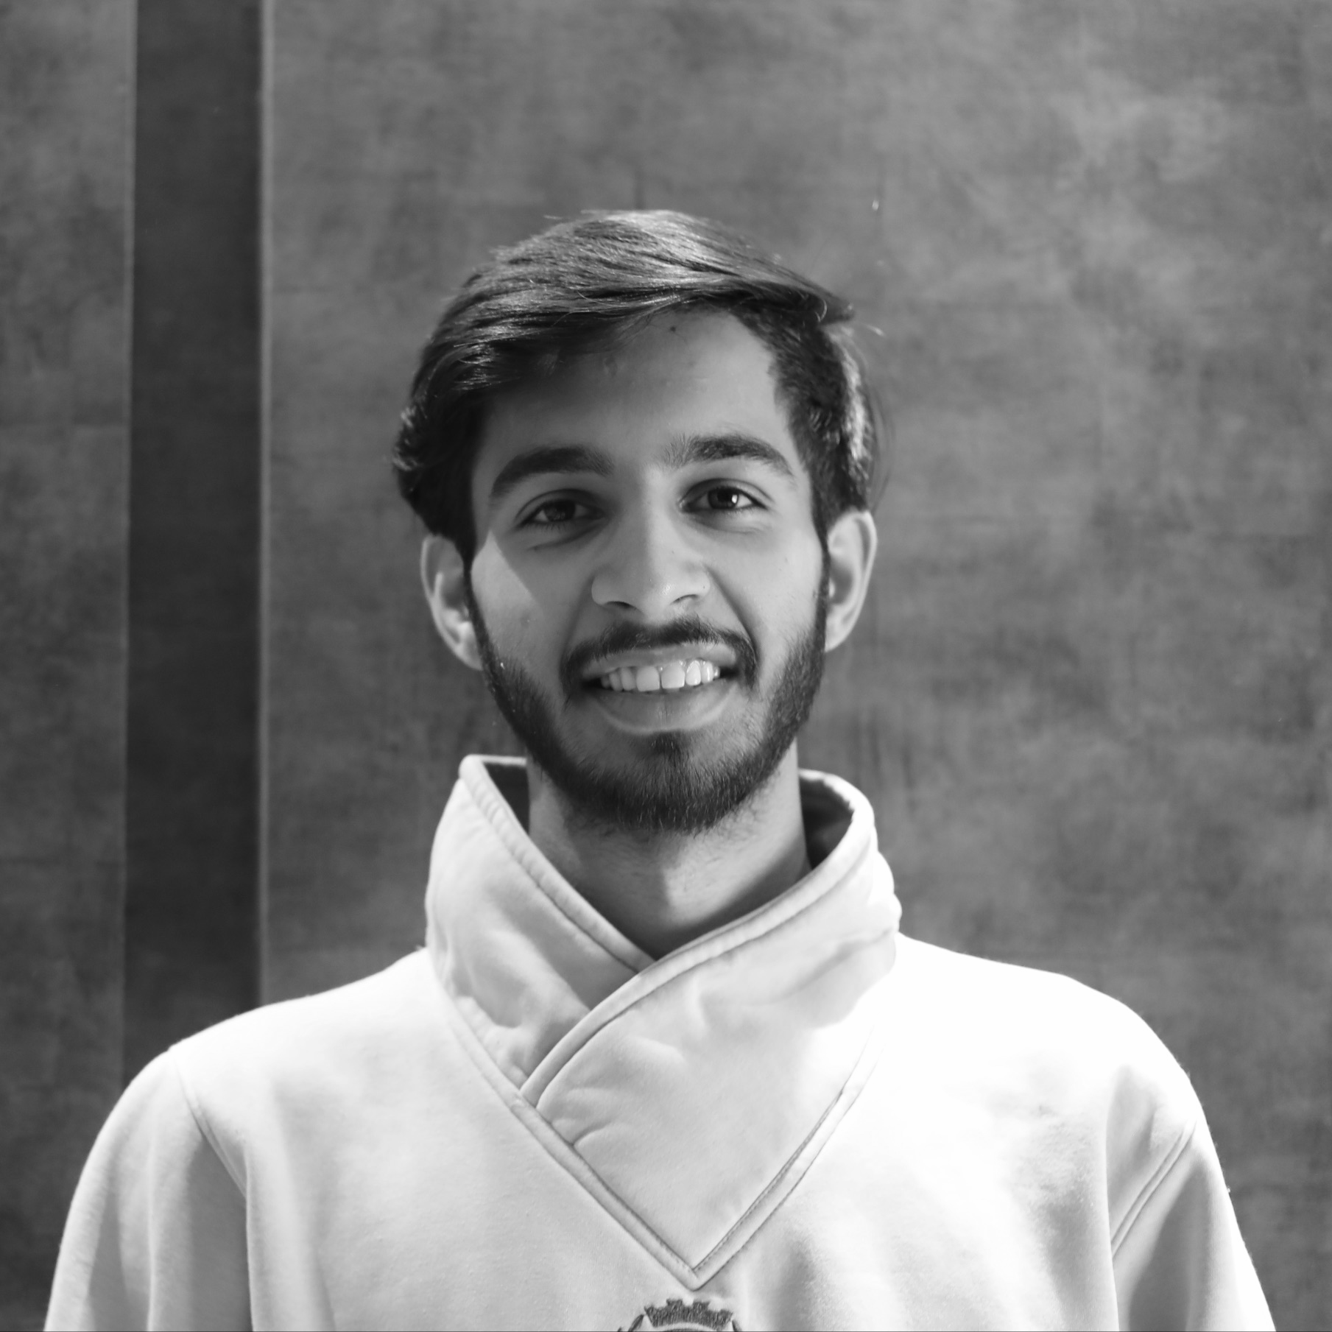
Our Team
Muhammad Soliman
Youssef Badreldin
Junior Software Engineering Student at Alamein International University
Junior Software Engineering Student at Alamein International University
Keshav Bhateja
Senior Computer Science Student at Virginia Tech University

Slide 23
Thank You!
!شكراً
Any Questions?

